Slide 1
PRESIDENCY UNIVERISTY, BENGALURU, School of Engineering
Computer Organization and Architecture
CSE 2009
Module-3: Input/Output Design

Slide 2
Input/Output Design

Slide 3
INPUT-OUTPUT ORGANIZATION
The I/O subsystem of a computer provides an efficient mode of communication between the central system and the outside environment.
It handles all the input/output operations of the computer system.
Peripheral Devices
Input or output devices that are connected to computer are called peripheral devices.
For example: Keyboards, display units and printers are common peripheral devices.

Slide 4
There are three types of peripherals:
Input peripherals : Allows user input, from the outside world to the computer. Example: Keyboard, Mouse etc.
Output peripherals: Allows information output, from the computer to the outside world. Example: Printer, Monitor etc
Input-Output peripherals: Allows both input(from outside world to computer) as well as, output(from computer to the outside world). Example: Touch screen, network/LAN, etc.

Slide 5
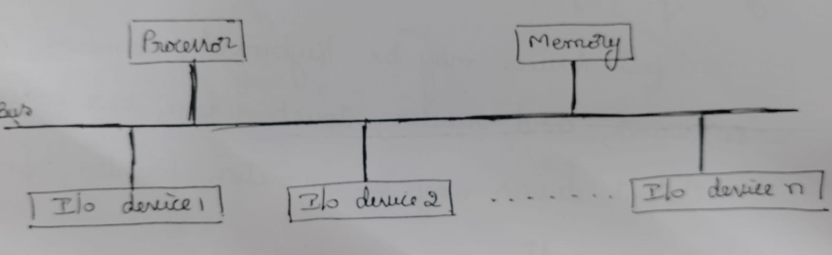
Accessing I/O devices
A single bus is used to connect I/O devices to a computer.
Since, there is a common bus, if more than one device is enabled at a time, data on the bus will be ambiguous & results in a problem called Bus contention.
To avoid this condition, each I/O device is assigned a unique address.
Only the addressed device is enabled & responds to the commands issued on the control lines.

Slide 6
Interfaces
In order to have an efficient & organized data transfer between processor & I/O devices, an intermediary is required. This is called as an I/O interface
Interface is a shared boundary between two separate components of the computer system which can be used to attach two or more components to the system for communication purposes.
There are two types of interface:
CPU Interface
I/O Interface

Slide 7
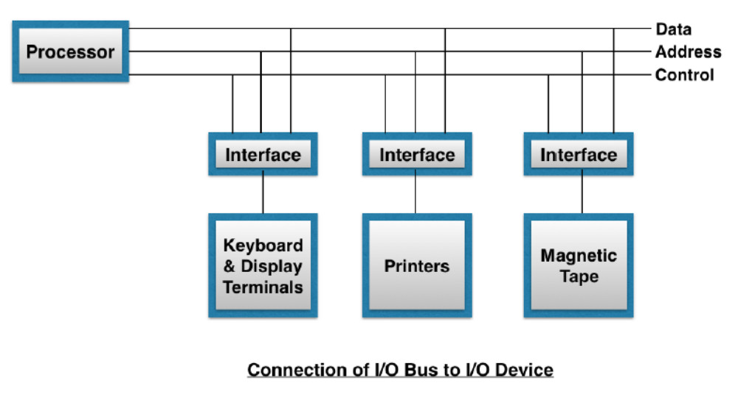
Input-Output Interface

Slide 8
The Input/output Interface is required because there are exists many differences between the central computer and each peripheral while transferring information. Some major differences are:
Peripherals are electromechanical and electromagnetic devices and their manner of operation is different from the operation of CPU and memory, which are electronic device. Therefore, a conversion of signal values may be required.
The data transfer rate of peripherals is usually slower than the transfer rate of CPU, and consequently a synchronisation mechanism is needed.
Data codes and formats in peripherals differ from the word format in the CPU and Memory.
The operating modes of peripherals are differ from each other and each must be controlled so as not to disturb the operation of other peripherals connected to CPU.
These differences are resolved through input-output interface.

Slide 9

There are two techniques for addressing an I/O device by CPU:
Memory mapped I/O
I/O mapped I/O (Standard I/O or Isolated I/O or port I/O)

Slide 10
I/O mapped I/O (Isolated I/O)
In this technique, memory & I/O address space are different.
Advantage is, I/O devices deal with fewer address lines resulting in smaller decoder size & simpler hardware
Here two separate address spaces are used - one for memory location and other for I/O devices
I/O read and I/O write lines for I/O transfer
Memory Write and Memory Read for memory transfer
It uses separate instructions, IN & OUT for data transfer.. Since, it uses only 2 instructions, it provides better programming environment.
Even though, there is separate address space for I/O & memory, there is only one address lines on the processor bus.
Hence, special signal on the bus indicates whether the sent address is for memory or I/O device.
IN and OUT instruction deals with I/O transfer and MOV with memory transfer.

Slide 11

When I/O devices & the memory share the same address space, the arrangement is called memory mapped I/O
MSB of the address bus is used to differentiate I/O & memory.
Since, I/O is also considered as memory, any data transfer instruction like move, load, etc can be used to exchange information.
In this scheme only one address space is used by CPU. Some addresses of the address space are assigned to memory location and other are assigned to I/O devices.
There is only one set of read and write lines. Hence there is no separate IN,OUT instructions. MOVE instruction can be used to accomplish both the transfer.
In this memory mapped I/O, buffer is associated with each I/O device & uses the machine instruction to access the device.

Slide 12
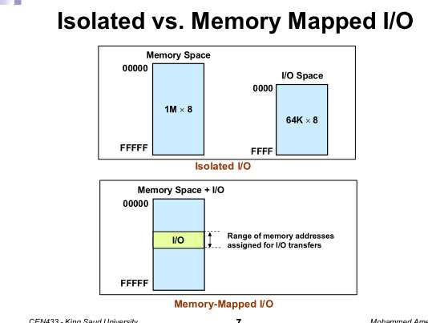

Slide 13
In memory mapped I/O the same address cannot be assigned to both memory location and I/O devices

Slide 14
I/O COMMUNICATION TECHNIQUES
The speed of operation of the processor & I/O devices differ greatly.
So there should be synchronization between CPU operations & I/O operations with reference to CPU clock.
To provide the different needs of I/O operations, 3 mechanisms have been developed for interfacing I/O devices. They are
  Programmed controlled I/O
  Interrupt I/O
  Hardware controlled I/O or Direct Memory Access(DMA)

Slide 15
Programmed Controlled I/O
Consider an example, Keyboard & Display are connected to CPU.
Flags SIN & SOUT are associated with them
Status register SIN is set to 1 when a character is entered at the keyboard & cleared to 0 once this character is read by the processor.
Hence, by checking SIN flag, software can ensure that it is always reading valid data.
When SIN=1, program reads the input data register
Similar procedure can be used to control output operations using an output status flag SOUT
In this method, processor repeatedly check the status flag to achieve synchronization with an I/O device for data transfer. That means processor polls the device
Processor wastes some time to check the status flag before transferring the data.

Slide 16
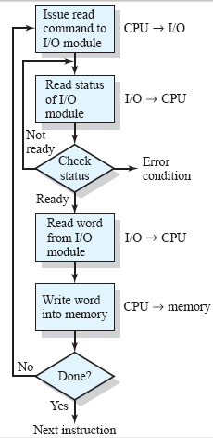
Programmed I/O
CPU while executing a program encounters an I/O instruction
CPU issues I/O command to I/ O module
I/O module performs the requested action & set status registers
CPU is responsible to check status registers periodically to see if I/O operation is complete. SO
No Interrupt to alert the processor
■

Slide 17
What Are Interrupts?
Instead of checking repeatedly whether I/O device is ready or not, we can make processor to perform some other task.
When I/O device is ready, we should make a arrangement such that, I/O device signals(alerts) processor saying that I/O device is ready now.
It can be done by sending a hardware signal called interrupt to the processor
At least one of the bus control lines, called interrupt-request line is usually dedicated for this purpose.
A Suspension of a process such as the execution of a computer program, caused by an event external to that process, and performed in such a way that the process can be resumed.
A way to improve processor utilization.

Slide 18
How Interrupts Are Handled?
The routine executed in response to an interrupt request is called Interrupt Service Routines (ISR).
When CPU is interrupted
  It stops what it was doing, and context is saved.
  A generic routine called Interrupt Handling Routine (IHR) is run which
i.e. processor examines the nature of interrupt and calls the corresponding Interrupt Service Routine (ISR) -- stored in lower part of memory.
After servicing the interrupt, the saved address is loaded again to PC to resume the process again.

Slide 19
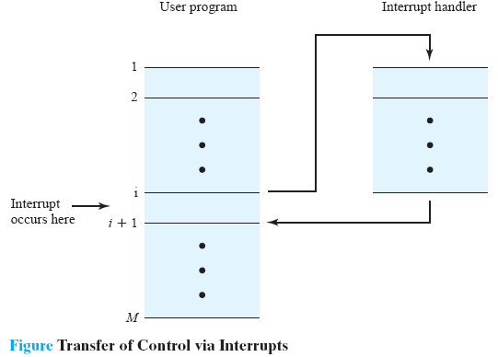
How Interrupts Are Handled? (Cont.)

Slide 20
Assume, Interrupt request arrives during execution of instruction I
When interrupt occurs, processor first completes the current instruction ( i in our ex),
Since, processor needs to come back to this routine back, contents of PC, pointing to the instruction i+1 is to be saved. This address is called return address
Then, the processor loads the PC with the address of the first instruction of ISR
A return from interrupt instruction at the end of ISR, reloads the return address into PC, causing the execution to resume at instruction i+1

Slide 21
Let us summarize the sequence of events involved in handling an interrupt request from a single device
Steps:
The device raises an interrupt request.
The processor interrupts the program currently being executed.
Interrupts are disabled by changing the control bits in the PS.
The device is informed that its request has been recognized, and in response, it deactivates the interrupt- request signal.
The action requested by the interrupt is performed by the interrupt-service routine.
Interrupts are enabled and execution of the interrupted program is resumed.

Slide 22
Direct Memory Access (DMA)

Slide 23
Introduction:
Already we discussed, how data or blocks of data can be transferred between the processor & I/O devices using 2 methods
  Programmed control I/O
  Interrupt I/.O
In programmed controlled I/O, data is transferred between processor & I/O devices using instructions
  Ex:- move DATAIN, R0
This instruction is executed by processor only after processor identifies that particular I/O device is ready
In order to check, whether I/O device is ready or not, processor has to check the status flag of device continuously i.e., polling
In order to transfer one word, processor has to execute one instruction in case of programmed controlled I/O
Normally, there are too many words will be transferred between processor & I/O devices.
So, processor is consuming too much of time.---→ disadvantage

Slide 24
In interrupt-I/O, data is transferred between processor & I/O devices using interrupts
Whenever, an I/O device is ready for data transfer, then it informs processor by raising an interrupt
After receiving the interrupt request, processor serves that interrupt request by executing its corresponding interrupt-service-routine.
Again, processor is taking too much of time
In both, programmed and interrupt I/O, processor is involved heavily & hence it consumes more time

Slide 25
Introduction:
In direct Memory Access(DMA), large set of data blocks are transferred between I/O devices & the main memory directly without intervention of processor.
In DMA, data is transferred between I/O devices & the main memory directly using an control circuit called DMA controller which is the part of I/O interface.
Whenever, DMA controller transfers each word, it provides the memory address & all the bus signals(data, address & control) in order to control each data transfer.
Usually, we need to transfer blocks of data, so DMA controller must increment the memory address for successive words & keep track of number of transfers.
In order to transfer block of words, DMA controller should be initiated by processor.

Slide 26
Introduction:
When processor initiates the DMA controller, then processor sends the following information to DMA controller
  Starting address (of data block)
  Number of words in the data block
  Direction of the transfer(input—memory OR memory---output)
It is also a fast way of transferring data within (and sometimes between) computer.
A DMA read transfers data from the memory
to the I/O device.
A DMA write transfers data from an I/O device
to memory.
The DMA controller temporarily borrows the address bus, data bus and control bus from the microprocessor and transfers the data directly from the external devices to a series of memory locations (and vice versa).

Slide 27
Basic DMA Operation:
Two control signals are used to request and acknowledge a direct memory access (DMA) transfer in the microprocessor-based system.
Peripheral sends a DREQ (DMA request) to DMAC, requesting a
DMA operation,
  DMAC sends a HOLD signal as an input(to the processor) requesting to get hold of it’s Data, Mem and Address buses.
  When the processor recognizes the hold, it stops its execution and enters hold cycles. The processor sends a HLDA ( HOLD ACK) signal to the DMAC acknowledging relinquishing control of the buses by placing them at high-impedance state.
  The DMAC send a DACK signal to the peripheral device acknowledging the DMA action..

Slide 28
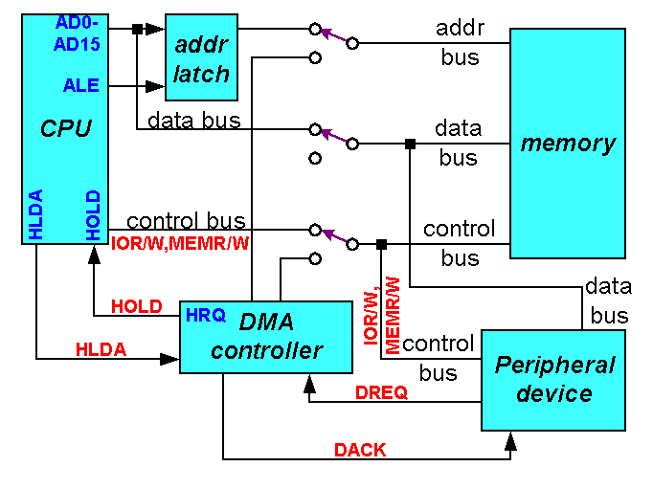
CPU having the control over the bus:

Slide 29

When DMA operates:

Slide 30
DMA Modes: Cycle Stealing & Burst mode
Main memory is not only accessed by processor or not only by DMA controller
Processor & DMA controller are interwoven. SO, there will be conflict between processor and DMA controller
Always, Requests made by DMA devices are having higher priority than processor requests (HOLD input has higher priority than INTR).
Among different DMA devices, top priority is given to high-speed peripherals (disks, high-speed network interface, graphics display device)
DMA operation will be done in 2 ways
  Burst mode
  Cycle stealing
processor uses most memory access cycles. When DMA wants to transfer data, then it has to steal some memory access cycles from processor, when processor is not accessing the main memory-----cycle stealing DMA transfer
If DMA controller is given exclusive access to the main memory to transfer a block of data without interruption, this is called block or burst mode..

Slide 31
Remember…
Data transfer speed is determined by speed of the memory device or a DMA controller.
In many cases, the DMA controller slows the speed of the system when transfers occur.
The serial PCI (Peripheral Component Interface) Express bus transfers data at rates exceeding DMA transfers.
This in modern systems has made DMA is less important.

Slide 32
End of Module 3

